Slide 1
Biosurvey
Andrew Perry and Komal Takhar

Slide 2
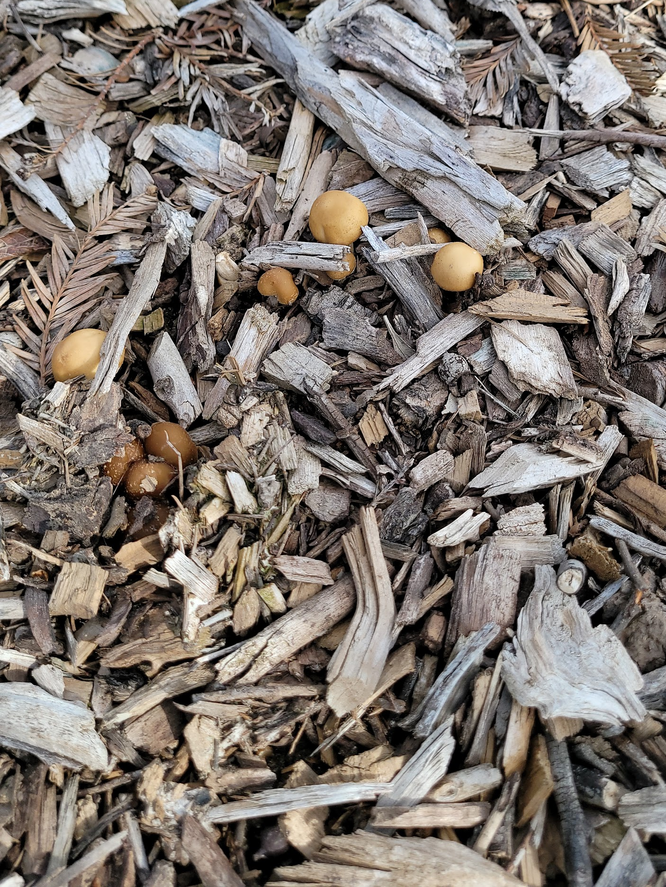
Fungi
Kingdom: Fungi
Phylum: Basidiomycota
Class: Agaricomycetes
Order: Agaricales
Family: Hymenogastraceae
Genus: Psilocybe
Species: Psilocybe allenii
Location: South side of campus, near Monte Vista
Date: 28 March 2024

Slide 3
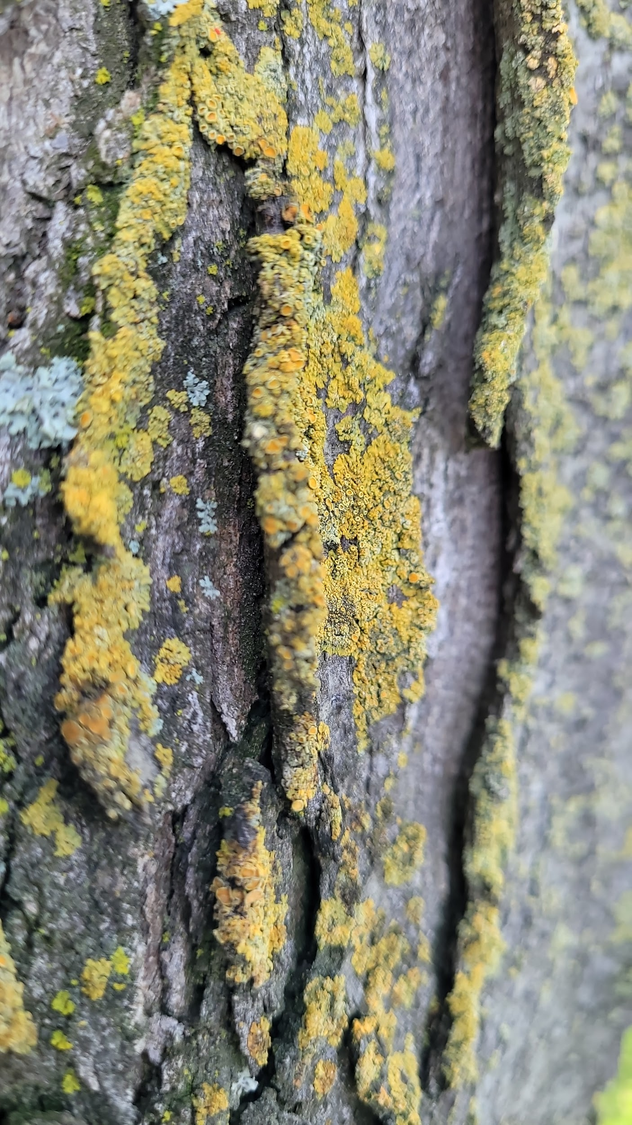
Lichen
Body Form: Crustose
Location: North side of tree by Monte Vista
Date: 17 April 2024

Slide 4
Plants

Slide 5
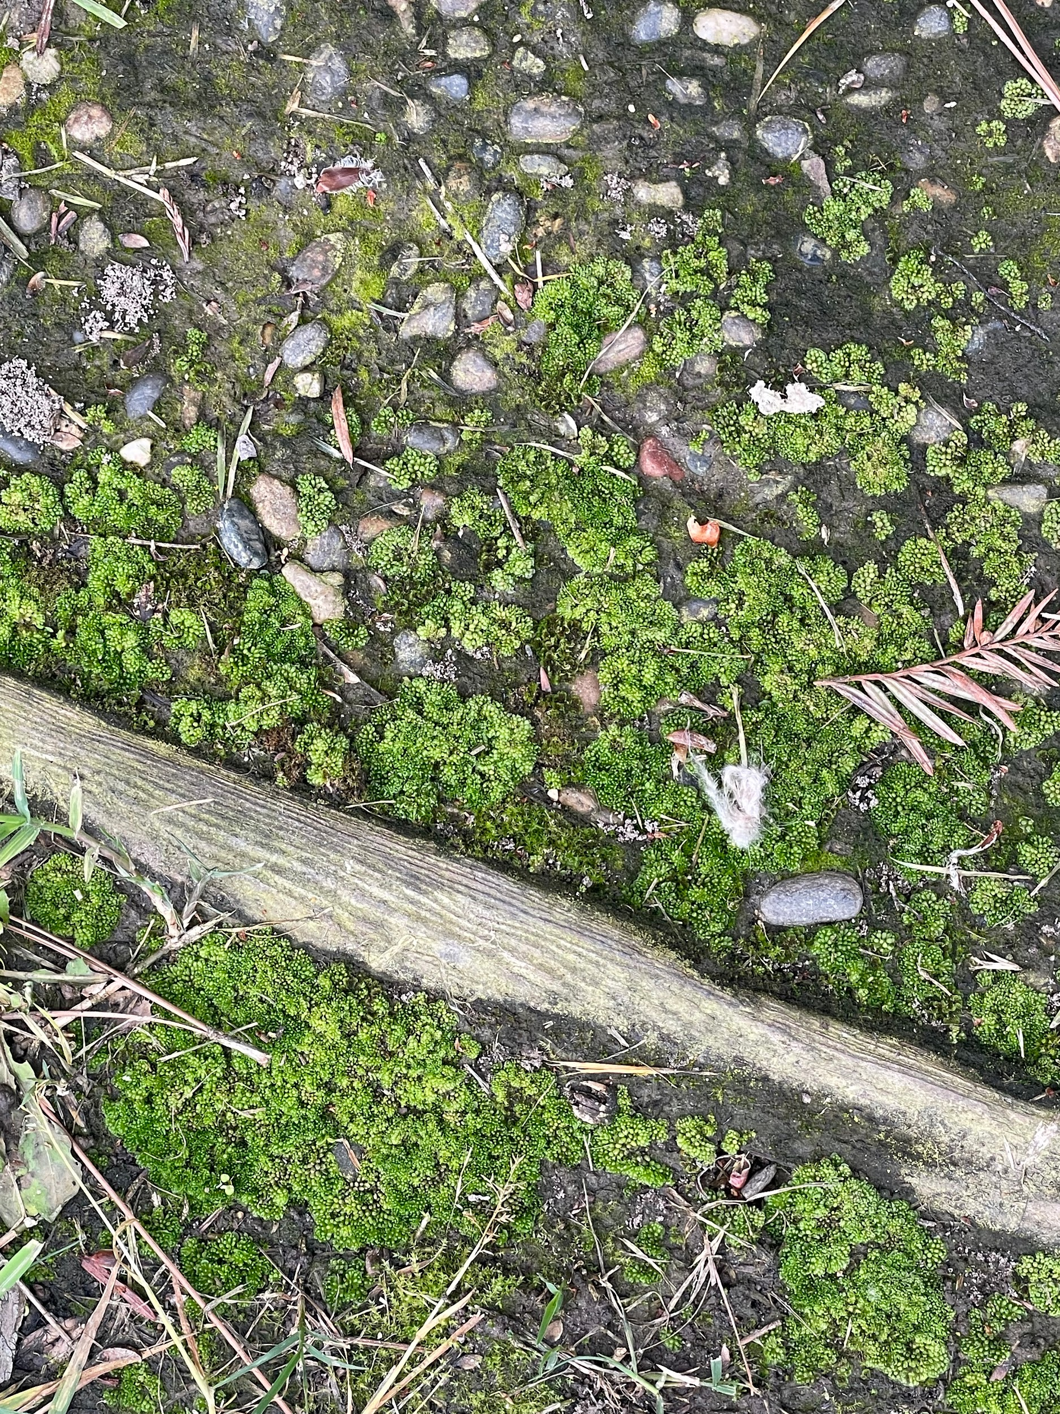
Bryophyta
Kingdom: Plantae
Phylum: Bryophyta
Class: Bryopsida
Order: Bryales
Family: Bryaceae
Genus: Bryum
Species: Bryum argenteum
Common name: Silvery Bryum
Location: Bizzini Hall
Date: 04/18/2024

Slide 6
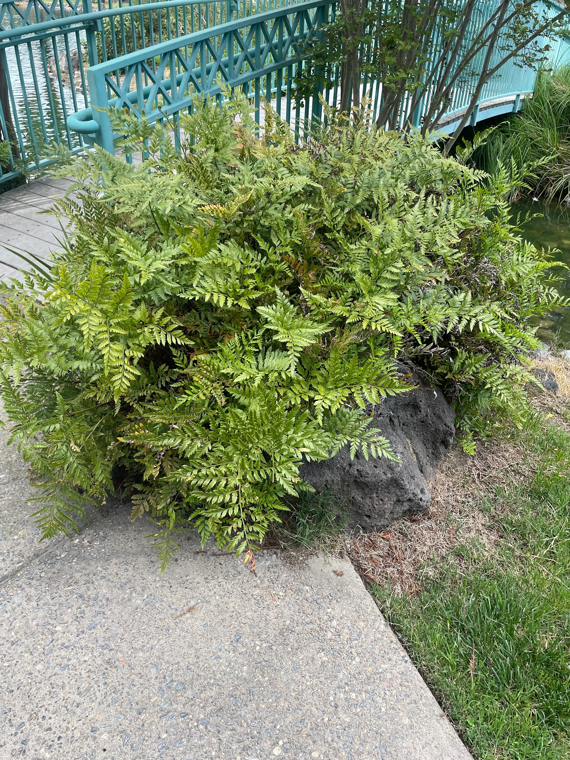
Pteridophyta
Kingdom: Plantae
Phylum: Tracheophyta
Class: Polypodiopsida
Order: Polypodiales
Family: Dryopteridaceae
Genus: Rumohra
Species: Rumohra adiantiformis
Common name: Leatherleaf Fern
Location: Bizzini Hall
Date: 04/18/2024

Slide 7
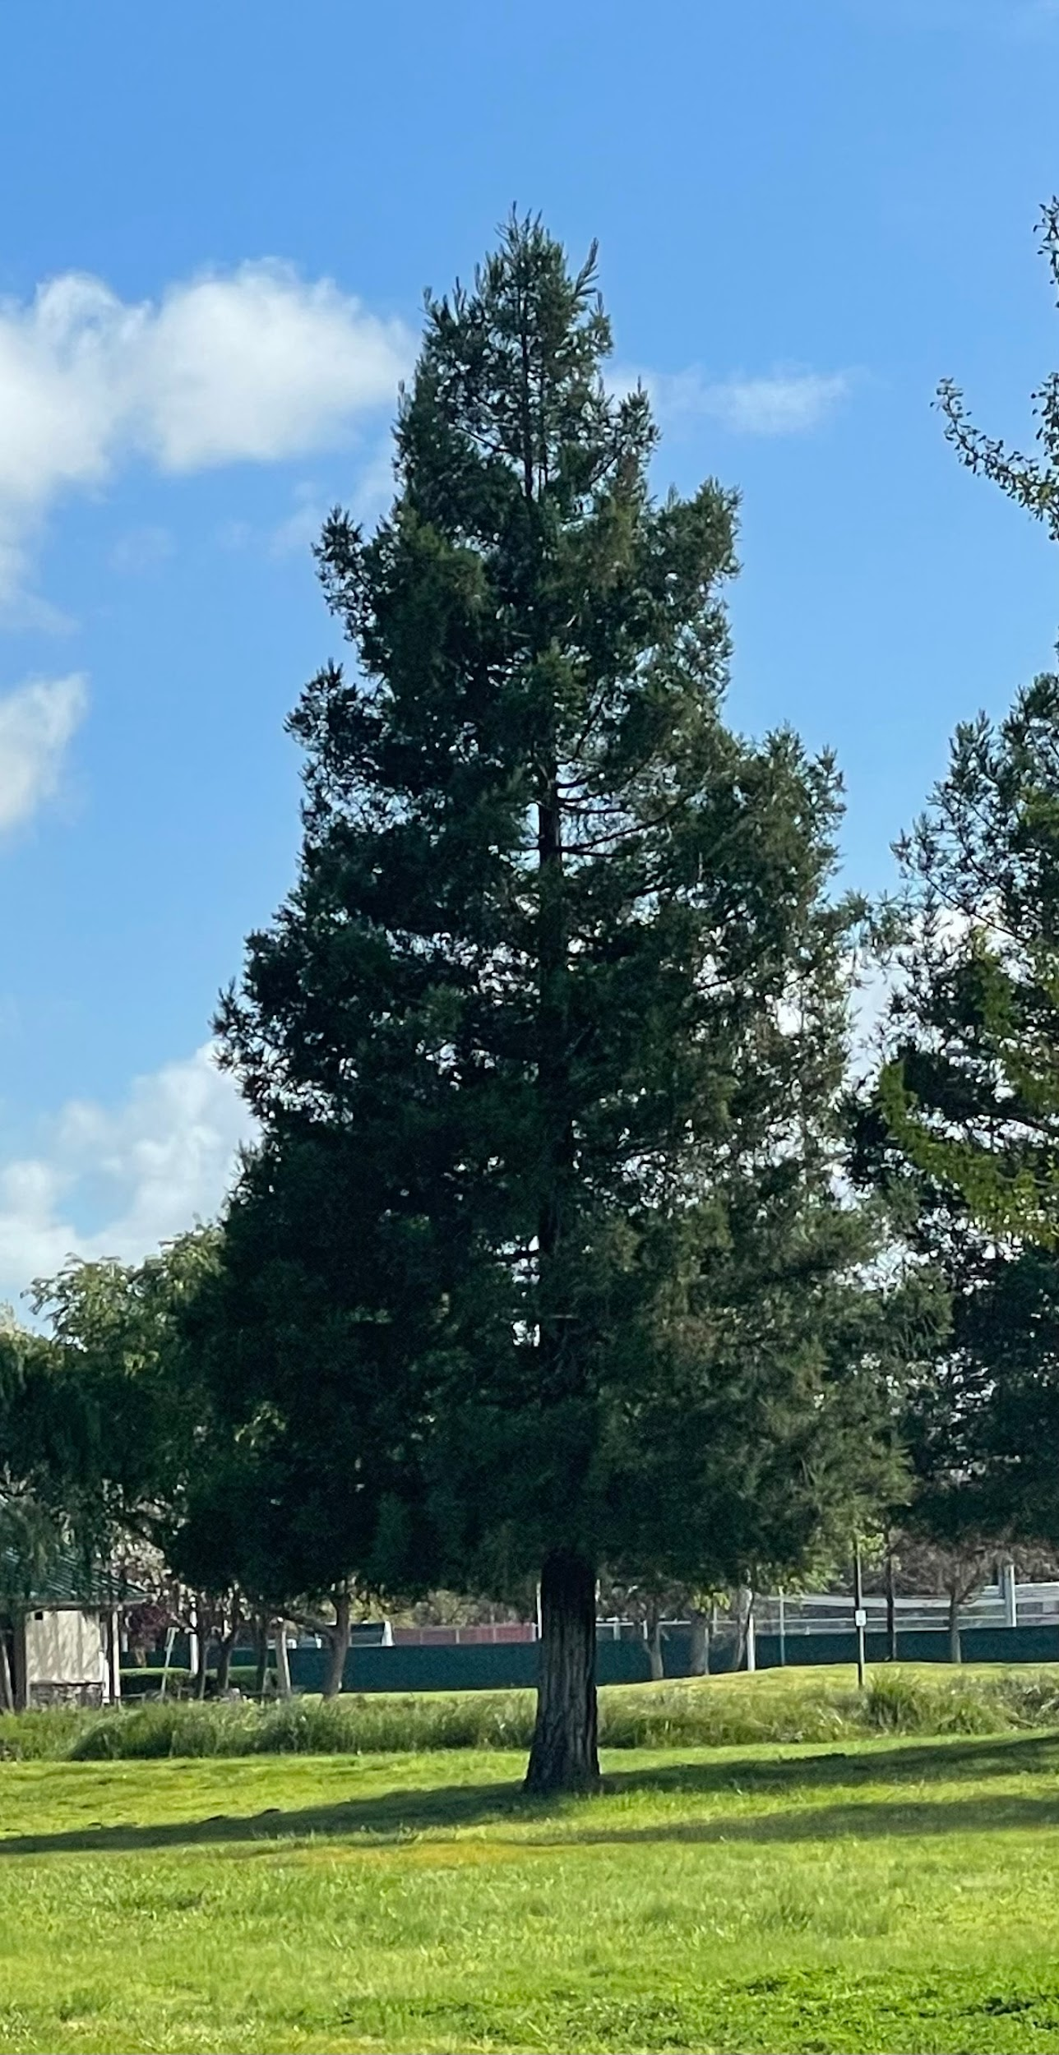
Gymnosperm
Kingdom: Plantae
Phylum: Tracheophyta
Class: Pinopsida
Order: Pinales
Family: Cupressaceae
Genus: Sequoia
Species: Sequoia sempervirens
Common name: Coast Redwood
Location: Near Warrior Lake
Date: 03/28/2024

Slide 8
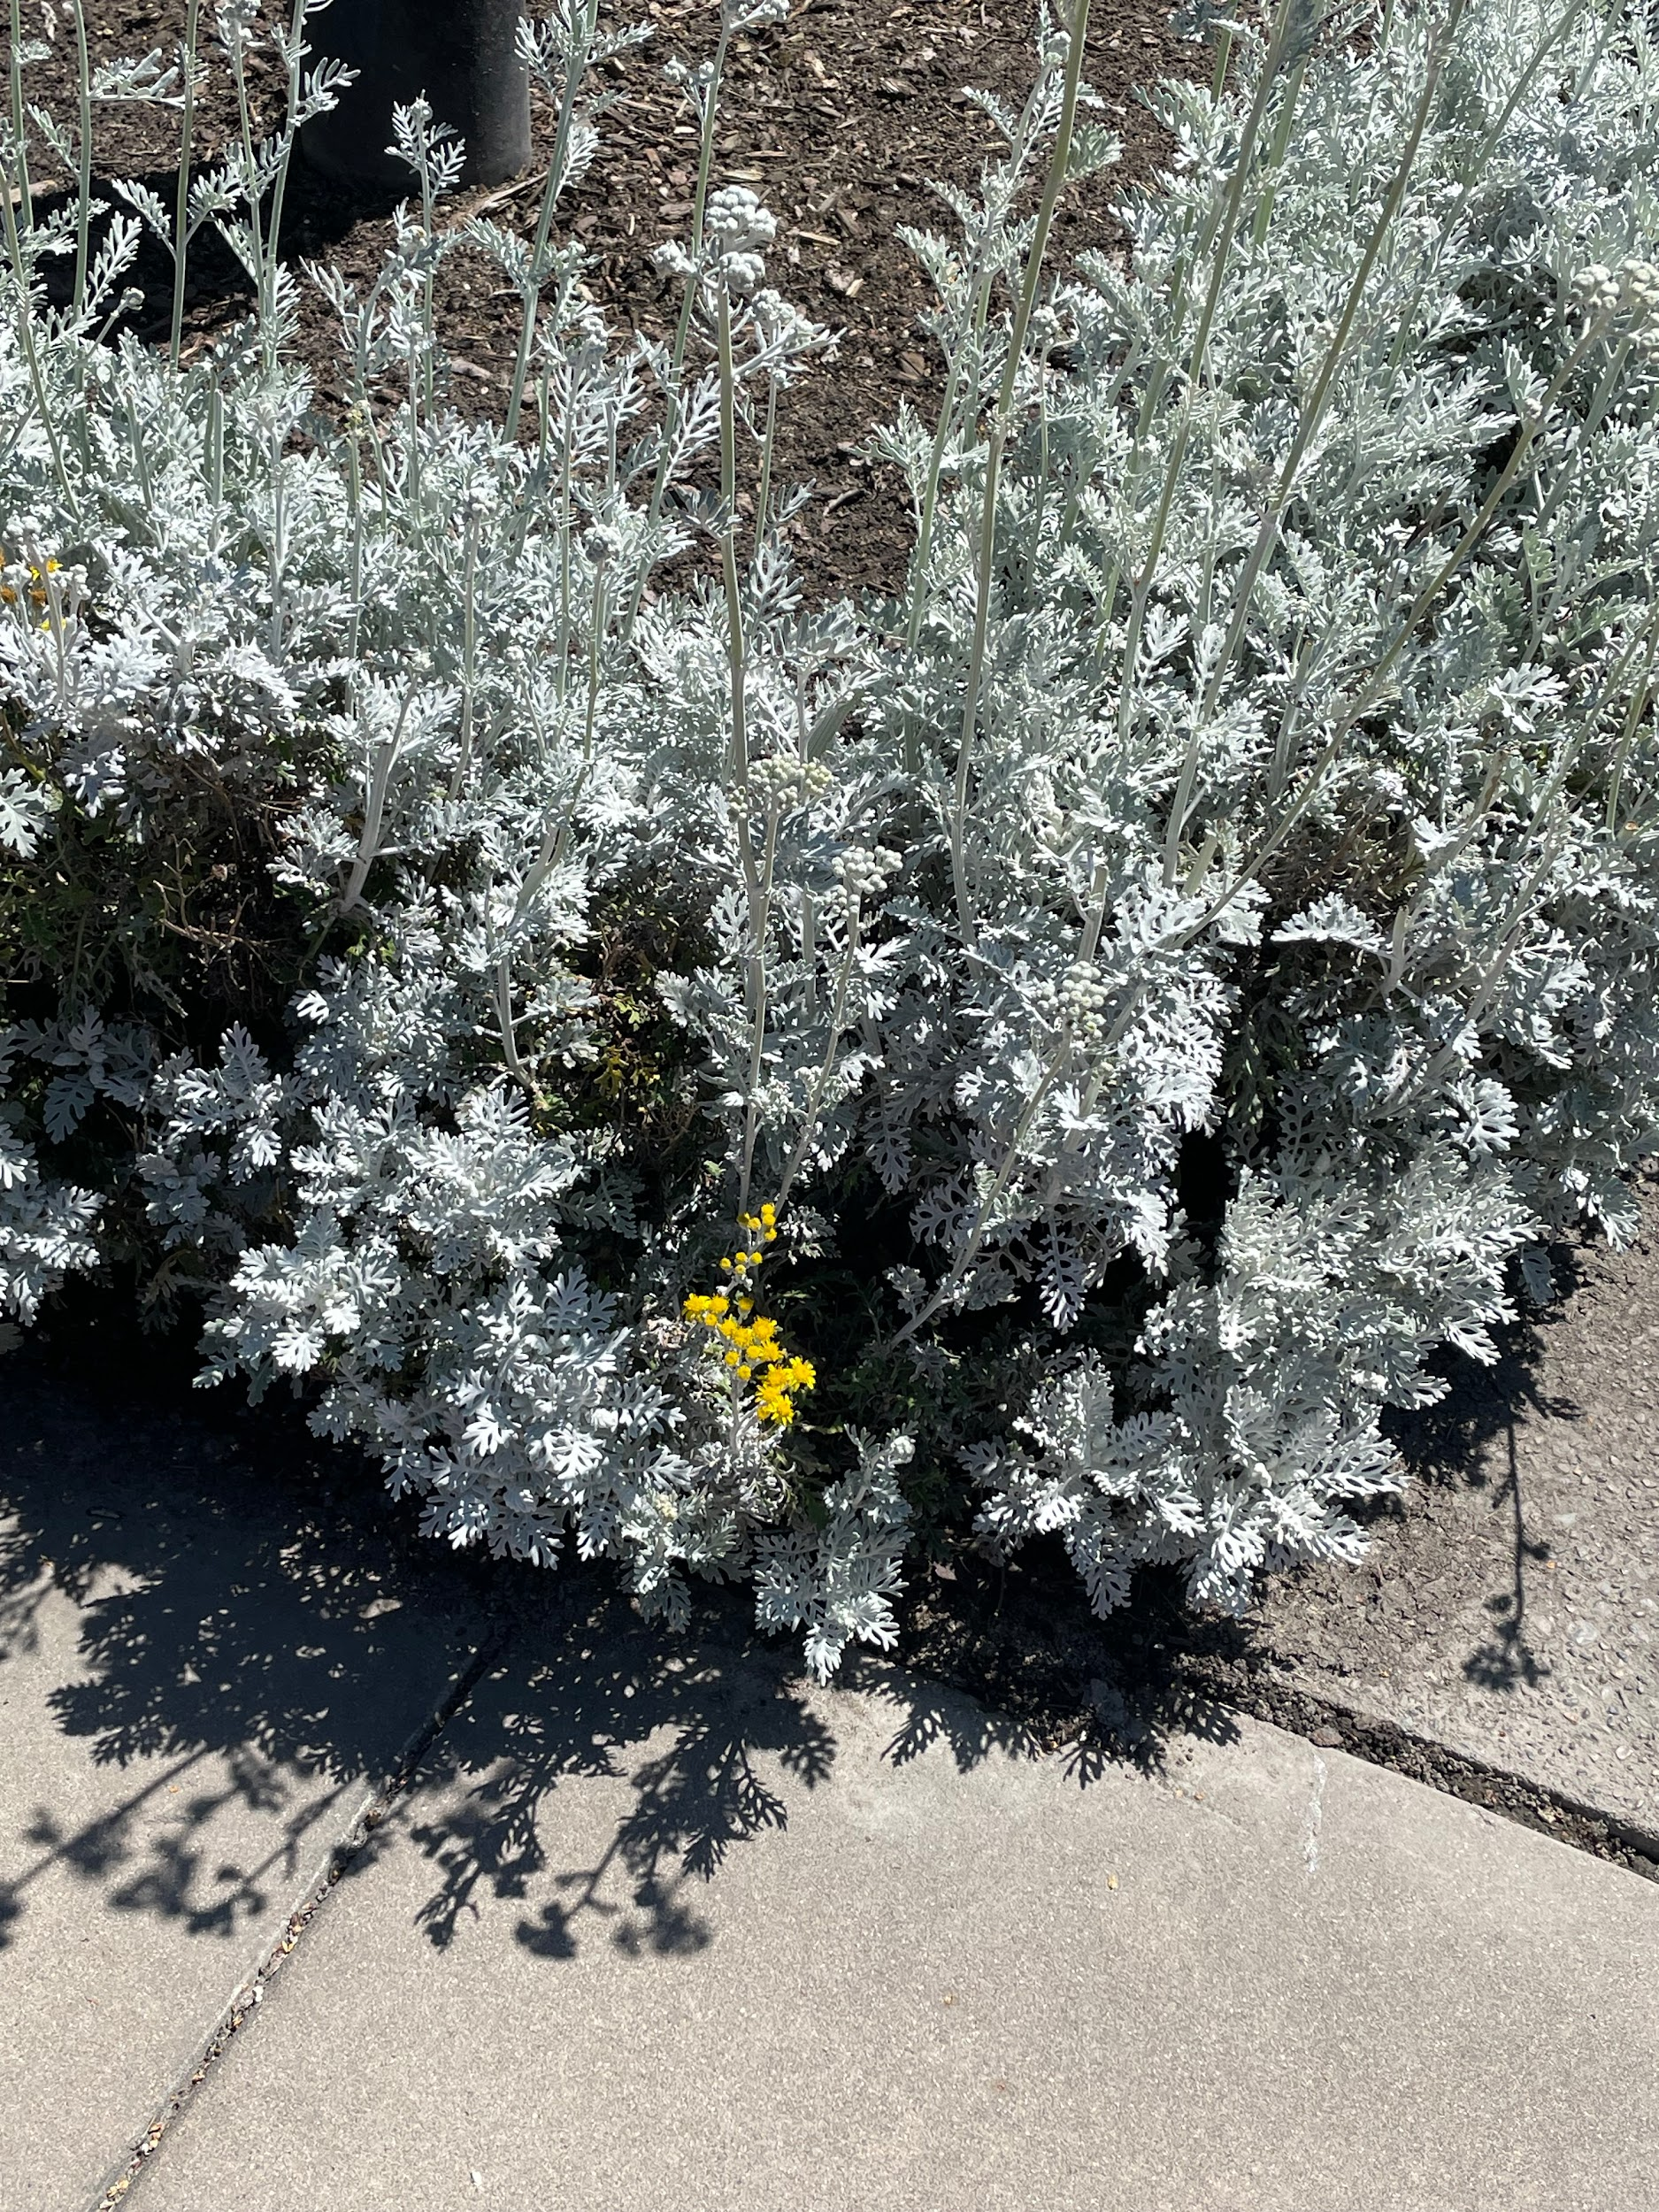
Angiosperm (1)
Kingdom: Plantae
Phylum: Tracheophyta
Class: Magnoliopsida
Order: Asterales
Family: Asteraceae
Genus: Jacobaea
Species: Jacobaea maritima
Common name: Dusty Miller
Location: The Quad
Date: 04/18/2024

Slide 9
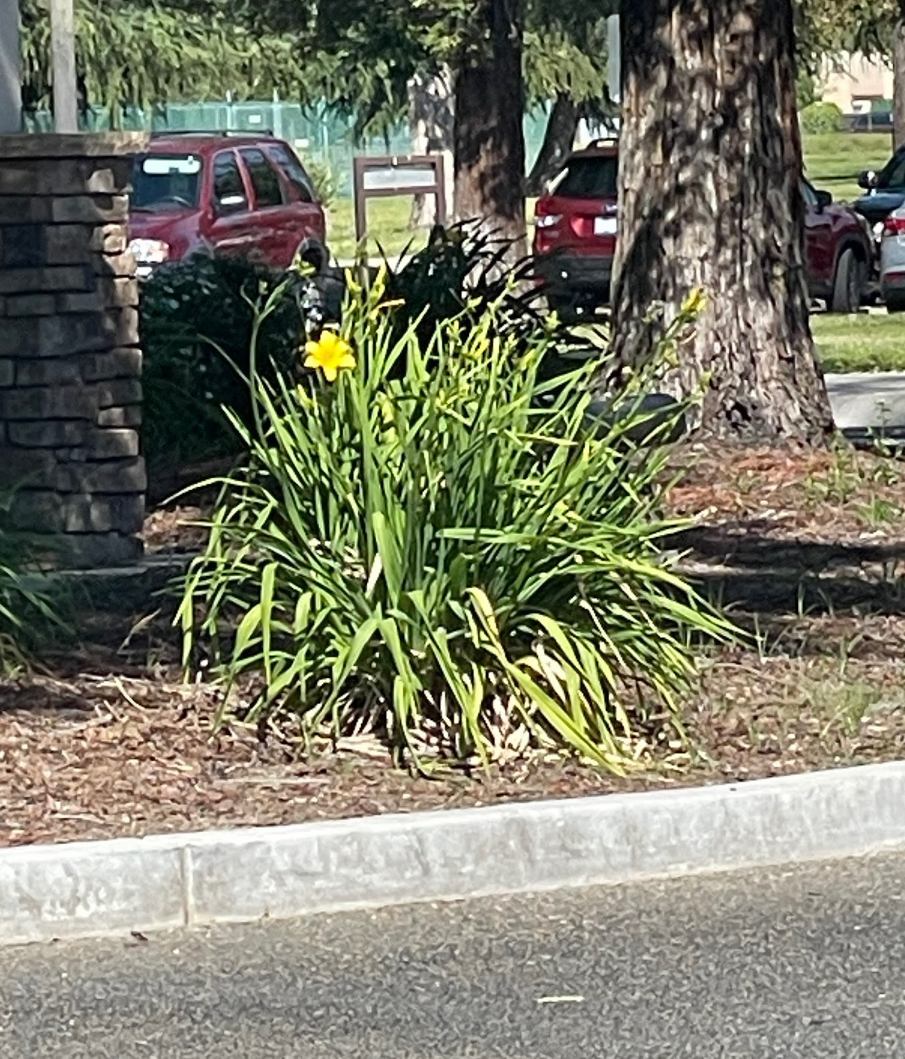
Angiosperm (2)
Kingdom: Plantae
Phylum: Tracheophyta
Class: Liliopsida
Order: Asparagales
Family: Asphodelaceae
Genus: Hemerocallis
Species: Hemerocallis liloasphodelus
Common name: Yellow Daylily
Location: John Stuart Rogers Faculty Development Center
Date: 04/11/2024

Slide 10
Animals

Slide 11
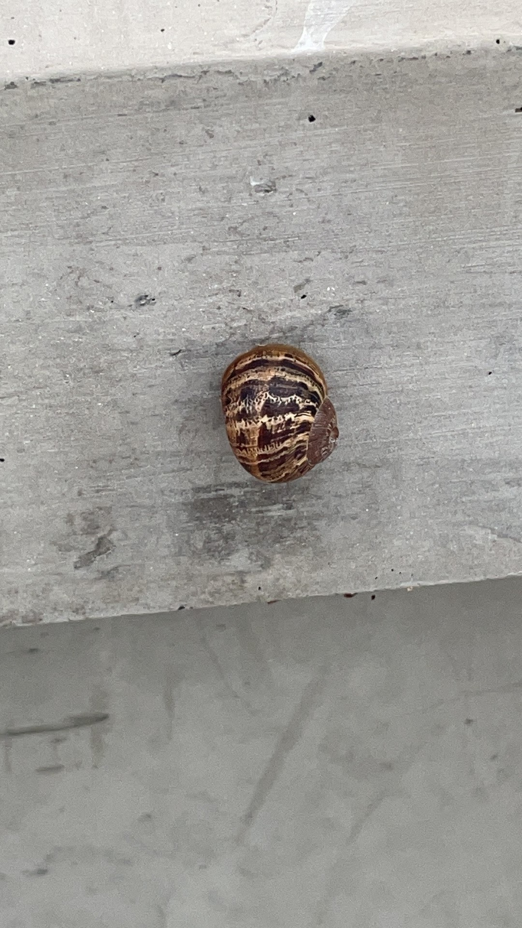
Mollusca
Kingdom: Animalia
Phylum: Mollusca
Class: Gastropoda
Species: Cornu aspersum
Common name: Garden Snail
Location: Near the Student Center
Date: 04/18/2024

Slide 12
Arthropoda

Slide 13
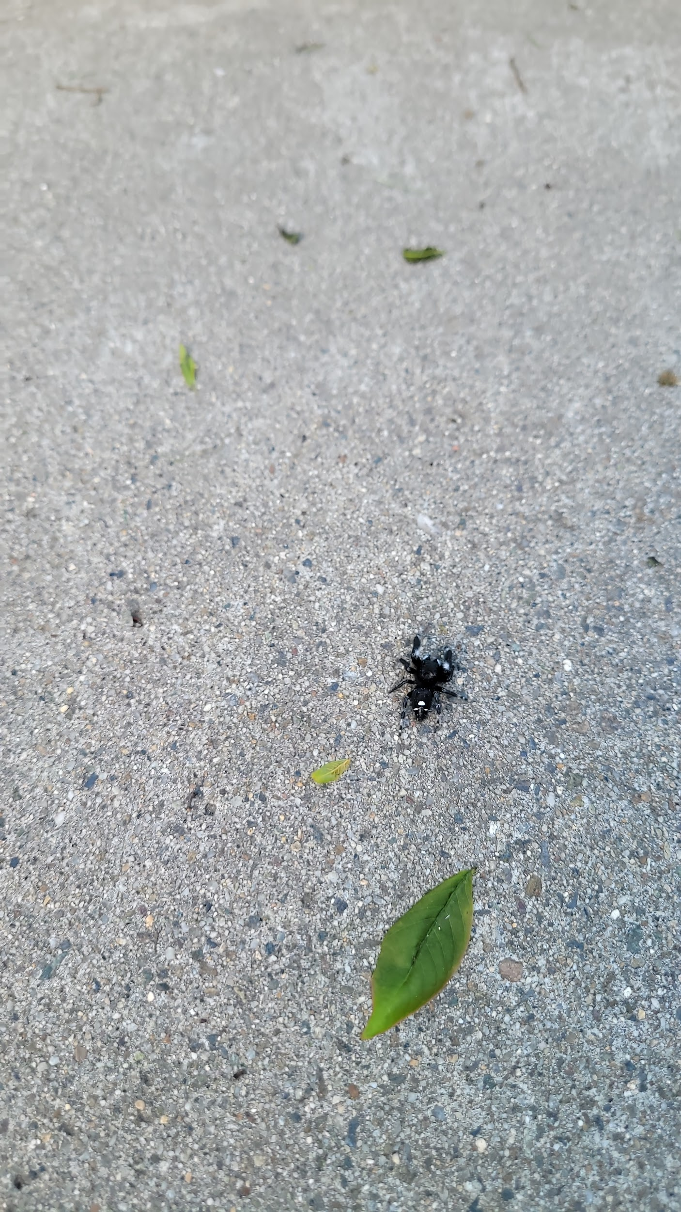
Chelicerata
Kingdom: Animalia
Phylum: Arthropoda
Subphylum: Chelicerata
Class: Arachnida
Order: Araneae
Family: Salticidae
Genus: Phidippus
Species: Phidippus audax
Common Name: Bold Jumping Spider
Location: South walkway from MSR
Date: 12 April 2024

Slide 14
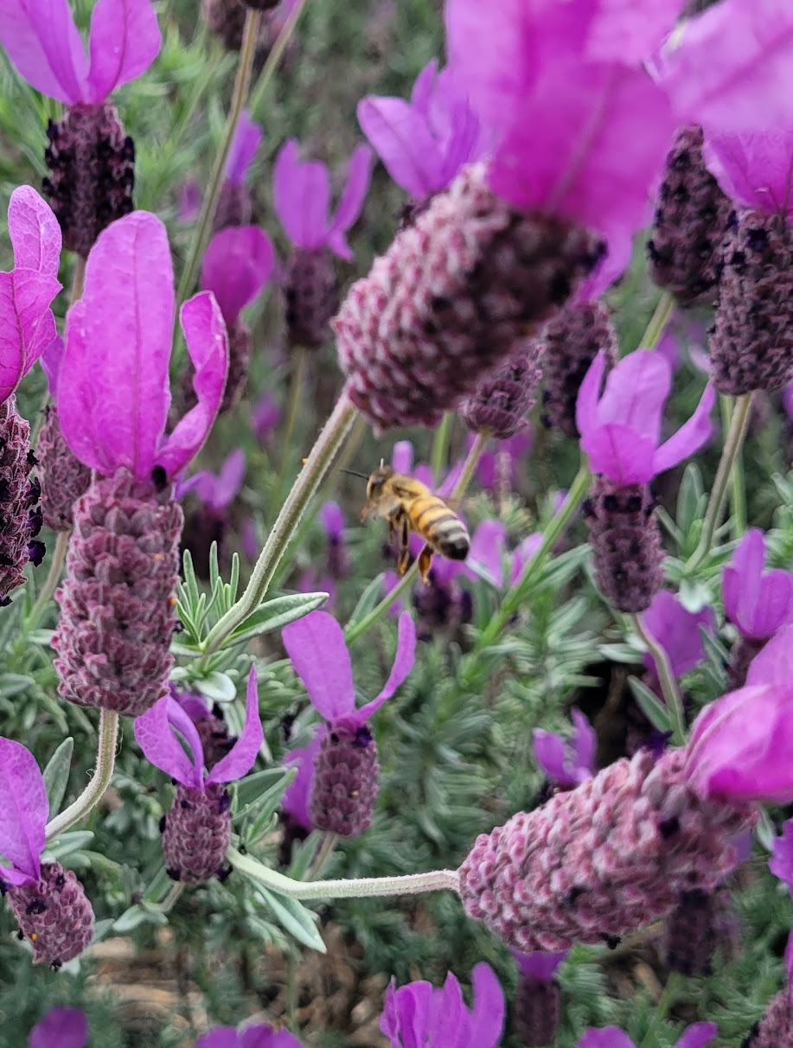
Hexapoda
Kingdom: Animalia
Phylum: Arthropoda
Subphyla: Hexapoda
Class: Insecta
Order: Hymenoptera
Family: Apidae
Genus: Apis
Species: Apis mellifera
Common Name: Western Honey Bee
Location: Lavender bushes between the north side of MSR and south of main dining.
Date: 18 April 2024

Slide 15
Chordata

Slide 16
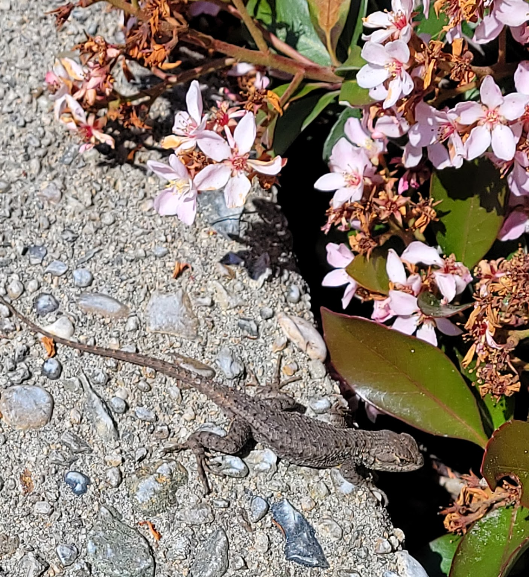
Reptilia
Kingdom: Animalia
Phylum: Chordata
Class: Reptilia
Order: Squamata
Family: Phrynosomatidae
Genus: Sceloporus
Species: Sceloporus occidentalis
Common Name: Western Fence Lizard
Location: Near a bush on the North side of the reflection pond
Date: 8 April 2024

Slide 17
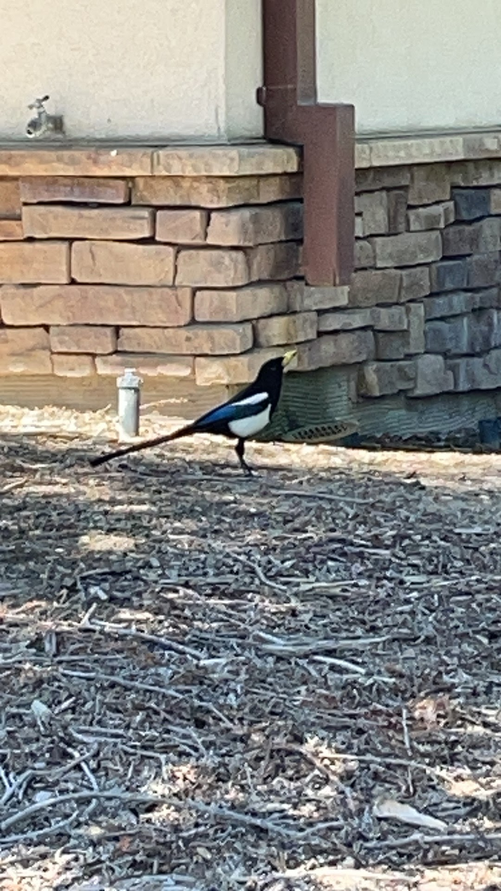
Aves
Kingdom: Animalia
Phylum: Chordata
Class: Aves
Order: Passeriformes
Species: Pica nuttalli
Common name: Yellow-billed Magpie
Location: John Stuart Rogers Faculty Development Center
Date: 04/18/2024

